Slide 1
Lecture 1: Welcome

Slide 2
Tell us about yourself
What is your name?
Where do you work?
What’s your major?
What do you hope to learn?
What kind of music are you into?
What are you excited about for this class?
etc.
Tell us a FUN FACT about yourself

Slide 3
What is this course about?
You will be hard coding your website
Learn about wire framing
Medium fidelity design mockups
Prototype your site
Deploy your site
You can use GitHub
Prefer you purchase your own Hosting/Domain name
Flow of building a website
Learning
How to ask questions
Where to find help
Networking/How the Internet work w/Guest Speaker
Frameworks/Utilities
What it’s like to design and then have to develop that design
Limitations and challenges of browsers

Slide 4


What we will learn
HTML 5
Content
Structure
CSS 3
Style
Presentation
JavaScript
Behavioral

Slide 5
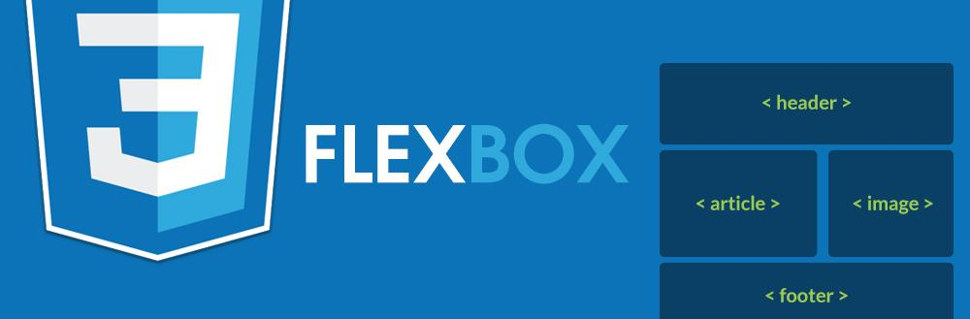

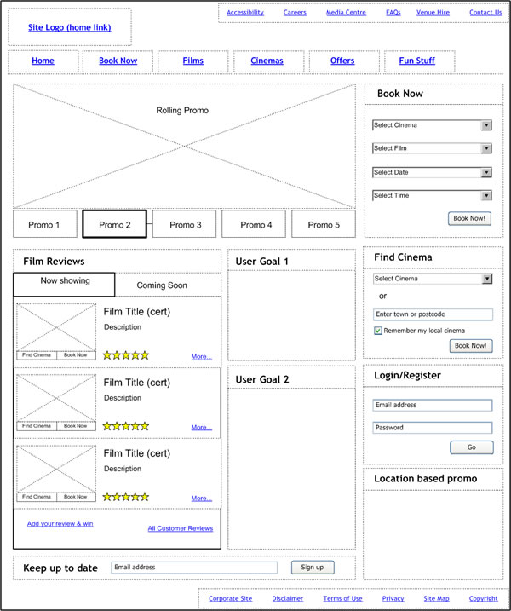

What we will learn

Slide 6


What we will learn
+
Git
GitHub

Slide 7


Coding Tools
Atom Text Editor
Used for coding
Flexible with plugins and themes
Made by the folks at GitHub
Available macOS/Windows
Free
GitHub Desktop
GUI for working with Git
“Easier” than working with Command Line
Made by the folks at GitHub
Available macOS/Windows
Free

Slide 8
Can I use other tools?
But I want to use
Sublime Text
Notepad++
Brackets
Vim
Emacs
Komodo
Visual Studio
Webstorm
If you travel this road you will be doing it as a lone wolf. As I’ve used many of these editors before I’m not advising it for this course. It makes everything run better when you use the tools of the many not the few.

Slide 9
Do we need to read the book?
Si
Oui
YES!!!
Hai
Shi
Ja
Sim

Slide 10
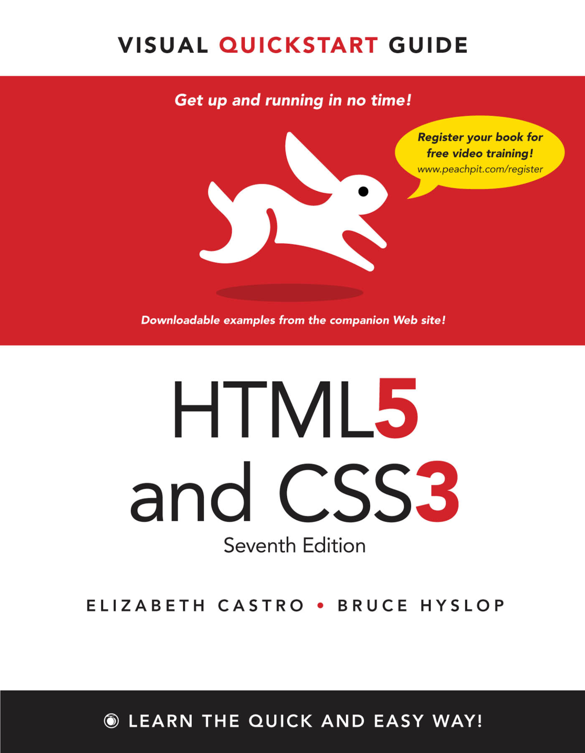

The book is expensive, we are “broke college kids”
Well then…
here it is for FREE

Slide 11
Why the book is important
Lectures are loosely based on chapters in the book
Reading the book
Will give you a head start
Help form questions
Introduce you to new concepts
Although this version of the book is dated the concepts are still relevant

Slide 12



You may (probably will) get to this point

Slide 13

Feeling meh, confused, frustrated, etc.
And sometimes you’re going to feel like this…
Ask questions
Raise your hand
Ask for help
Google it
Stack Overflow
Take a break
Help me help you
Email me: steve_fuller@berkeley.edu
Ask me to come to class early
Stay after class

Slide 14
Helpful resources
HTML w3schools
CSS w3schools
JavaScript w3schools
CSS Tricks
HTML 5 Cheatsheet
CSS Cheatsheet
Stack Overflow

Slide 15
The goal of this class
Your overall goal of this course is to build website for a band
Here is my band website
Minimum Website Requirements:
Homepage
Full screen image
HTML 5 Video (Bonus)
About page
X2 large paragraphs of text
X2 lists
Tell me all about the band I want to understand who they are and what they are about
Discography
X3 albums
Album covers, album title, release date, numbered tracks
Media
X8 thumbnail images
Images must have Lightbox effect
X3 embedded YouTube Videos
Merch
X6 merch items
Must be able to Filter items
X2 categories
Tour Dates
HTML Table
X10 Dates must be present
Link out to Venues and/or Where to Buy tickets
Deploy Site
GitHub
Hosting and Domain (Bonus)

Slide 16
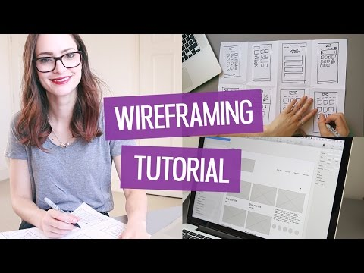
Wireframing
Video Link

Slide 17
What tools can I use to wireframe
You can essentially wireframe using any medium
You can use
Pen and Paper
Illustrator
Sketch
Photoshop
Draw.io
Balsamiq
If you use a digital format just make sure you are able to export as
.png
.jpeg/jpg
Canvas Size
Width: 1400px
Height: 1000px but allow for this to expand

Slide 18

Homework
Identify the band in which you want to create a site for
Wireframe
Homepage
About
Discography
Read Ch 3 & 6
Sign up for GitHub
Free Account
Get external storage
Cloud Storage Preferred
USB Flash Drive 8GB is more than enough

Slide 19
Index
jQuery
Git
GitHub
CSS Flexbox Guide
Bulma
HTML5/CSS3 Book
inVision
Demo Site
GitHub Desktop
Atom Text Editor
Wireframe Video

